Slide 1


Day 8: Consolidating Financial Data and Releasing Data
Financial Consolidation
Release SAP S/4HANA data

Slide 2
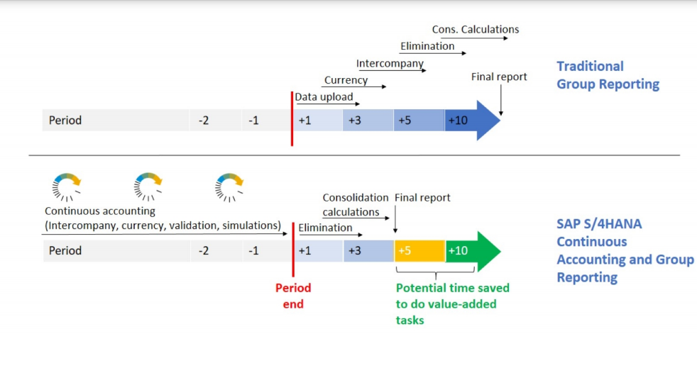
Release SAP S/4HANA data

Slide 3
